Slide 1


Slide 2
Forecasting using Data
Introduction to probabilistic forecasting Using data rather than estimates
Every spreadsheet and exercise worksheet is here:
Bit.ly/SimResources (gitHub)
or FocusedObjective.com (see “free stuff”)
or @t_magennis (I’ve post links here in my twitter feed)
Or email me: troy.magennis@focusedobjective.com

Slide 3
Every spreadsheet and exercise worksheet is here:
Bit.ly/SimResources (gitHub)
or FocusedObjective.com (free stuff)
or @t_magennis (I’ve post links here)

Slide 4

Probability Refresher
Undo all of the statistics you learnt in school
Sampling
Learn how much data we need to forecast
Getting Data
Learn how to get historical data and estimates
Forecasting with Data
Practice using historical data to forecast

Slide 5
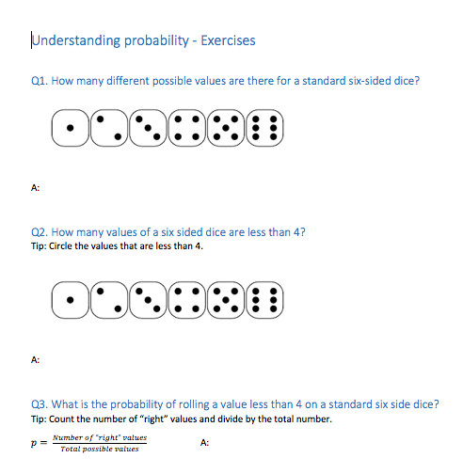
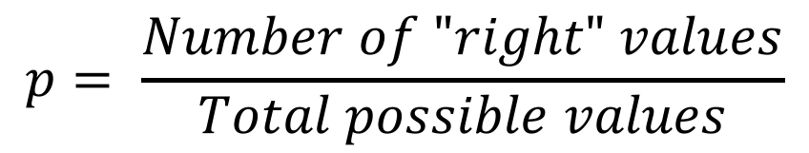
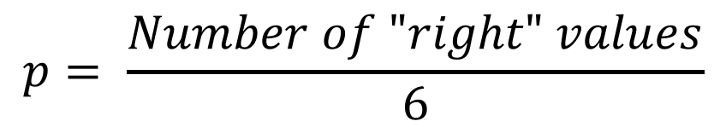
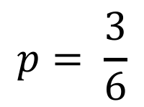
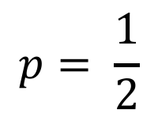
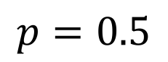
$$p= \frac{Number of "right" values}{Total possible values}$$
$$p= \frac{Number of "right" values}{6}$$
$$p= \frac{3}{6}$$
$$p= \frac{1}{2}$$
$$p=0.5$$

Slide 6
Finish the rest of the probability questions
3 minutes

Slide 7
Probability Refresher
Undo all of the statistics you learnt in school
Sampling
Learn how much data we need to forecast
Getting Data
Learn how to get historical data and estimates
Forecasting with Data
Practice using historical data to forecast

Slide 8
Sampling
A way to use the data we do have to make predictions & forecasts
It helps discover the range of possible values fast and reliably

Slide 9
Q. How quickly do we discover a range of values by sampling?
Why? Because as we get story count, story size, velocity, Throughput, cycle-time. How confident should we be of having found the full range values.

Slide 10
Q. On average, what is the chance of the 4th sample being between the range seen after 3 random samples? (no duplicates, uniform distribution)
Actual Maximum
Highest sample so far
2
1
A. ?
4
3
Lowest sample so far
Actual Minimum

Slide 11
Q. On average, what is the chance of the 4th sample being between the range seen after 3 random samples? (no duplicates, uniform distribution)
Actual Maximum
Highest sample so far
25% chance higher than previous highest seen
2
25%
1
A. ?
4
25%
3
Lowest sample so far
25% chance lower than previous lowest seen
Actual Minimum

Slide 12
Q. On average, what is the chance of the 4th sample being between the range seen after 3 random samples? (no duplicates, uniform distribution)
Actual Maximum
Highest sample so far
25% chance higher than previous highest seen
2
50% % = (n – 1)/(n+1) % = (3-1)/(3+1) % = 2/4 = 1/2 % = 0.5
25%
1
4
25%
3
Lowest sample so far
25% chance lower than previous lowest seen
Actual Minimum

Slide 13
Q. On average, what is the chance of the 12th sample being between the range seen after 11 random samples? (no duplicates, uniform distribution)
Actual Maximum
8.5% chance higher than previous highest seen
7
Highest sample so far
2
83% % = (n-1)/(n+1) % = (11-1)/(11+1) % = 0.833
1
10
12
5
11
3
6
4
8
Lowest sample so far
9
8.5% chance lower than previous lowest seen
Actual Minimum

Slide 14
Prediction Intervals
n | (n-1)/(n+1) | n | (n-1)/(n+1)
2 | 33% | 16 | 88%
3 | 50% | 17 | 89%
4 | 60% | 18 | 89%
5 | 67% | 19 | 90%
6 | 71% | 20 | 90%
7 | 75% | 21 | 91%
8 | 78% | 22 | 91%
9 | 80% | 23 | 92%
10 | 82% | 24 | 92%
11 | 83% | 25 | 92%
12 | 85% | 26 | 93%
13 | 86% | 27 | 93%
14 | 87% | 28 | 93%
15 | 88% | 29 | 93%
 |  | 30 | 94%
“n” = number of prior samples
% chance next sample in previous range for prior sample count

Slide 15
Experiment
From a *known* range of values, take samples at random and see how fast we can determine what the full range *might* be.
Compare two ways –
From the (n-1)/(n+1) formula
By doubling the average (double what you are told)

Slide 16
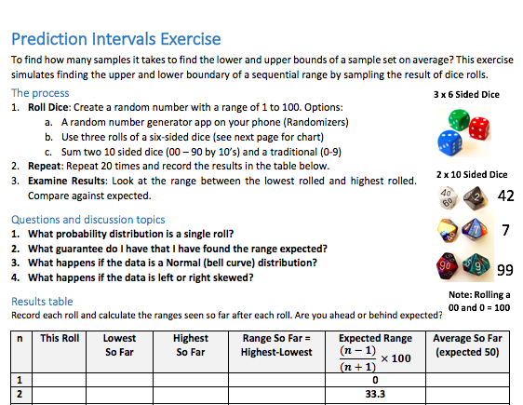

Slide 17
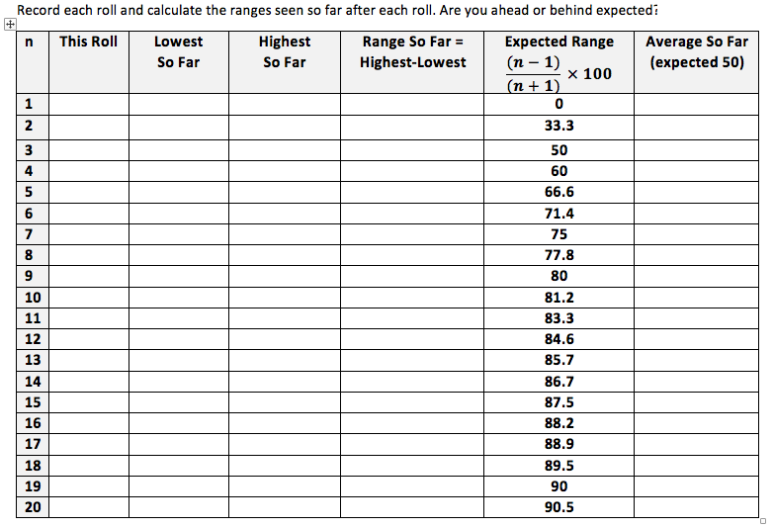
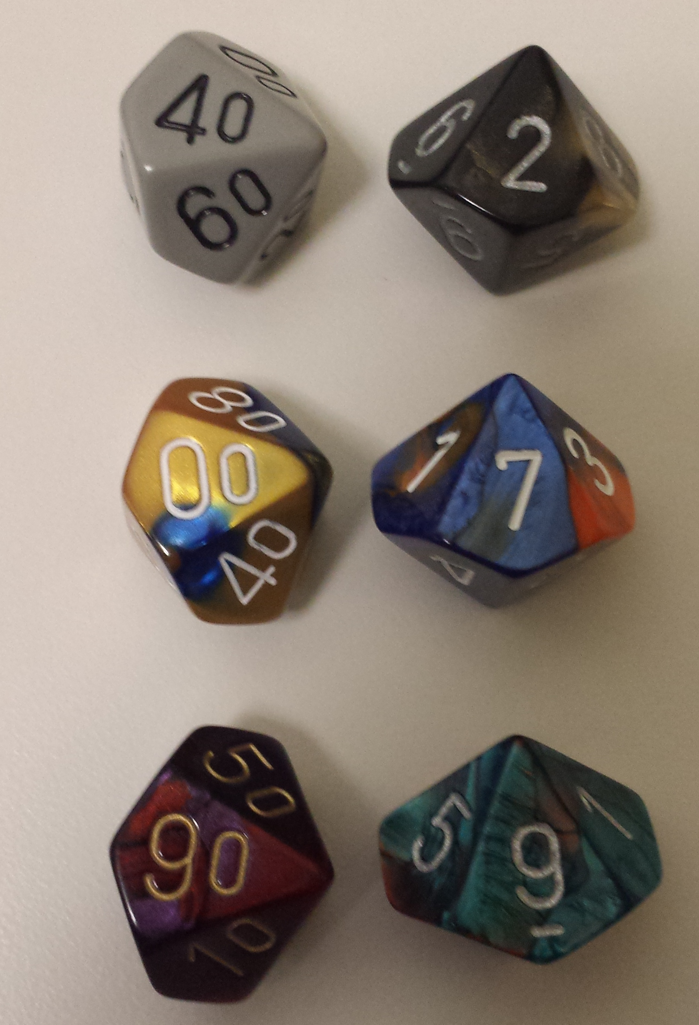
Sum all rolls up to each row and divide by n
42
7
99
10 minutes
00 & 0 = 100

Slide 18
Come to the front when completed. Compare with expected. How close to 9 samples is range of 80 found? (80% range, 10% above?)
Group | # samples > range > 80 | # samples until 2 x avg > 80
1
2
3
4
5
6
7
Group | # samples > range > 80 | # samples until 2 x avg > 80
8
9
10
11
12
13
14

Slide 19
Probability Refresher
Undo all of the statistics you learnt in school
Sampling
Learn how much data we need to forecast
Getting Data
Learn how to get historical data and estimates
Forecasting with Data
Practice using historical data to forecast

Slide 20
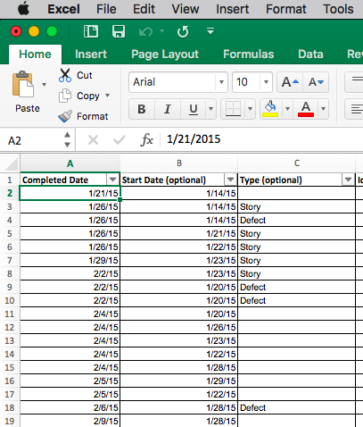
http://bit.ly/Throughput
Notes:
Here is the input page. Completed date is mandatory. Start date is optional but well advised. And the type of work. Is it planned or un-planned work is needed to see how these different types stack up. This is optional. Most people don’t use it, I’ll leave that up to you.

Slide 21
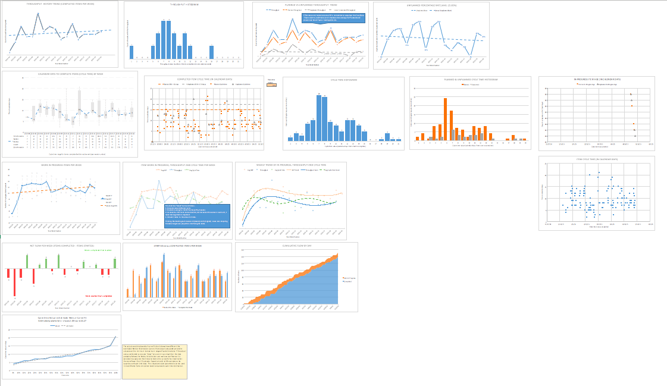
17 charts so far…
Throughput (planned & un-planned)
Throughput Histogram(s)
Cycle Time (planned & un-planed)
Cycle Time Histogram(s)
Work In Process
Cumulative Flow
Arrival vs Departure Rate
Un-planned work Percentage
Cycle Time Distribution Fitting
Notes:
The spreadsheet from just these three inputs creates 17 different charts so far. [click] Throughput rates and histograms. Cycle times values and histograms. Work in process rates, arrival and departure rates, cumulative flow diagrams. And some rather complex mathematical analysis of the cycle time histogram that fits the data to the Weibull probability distribution thanks to John Cook, someone who everyone in this industry should have heard of. It does all of this without macros. Everything is straight formula based. And all from 2 dates and one type column that’s optional.

Slide 22
http://bit.ly/Throughput
Demo the throughput data spreadsheet
What data do you need
See how to get that data

Slide 23
Probability Refresher
Undo all of the statistics you learnt in school
Sampling
Learn how much data we need to forecast
Getting Data
Learn how to get historical data and estimates
Forecasting with Data
Practice using historical data to forecast

Slide 24
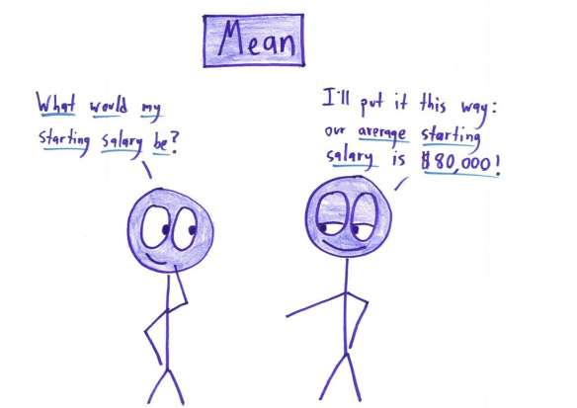
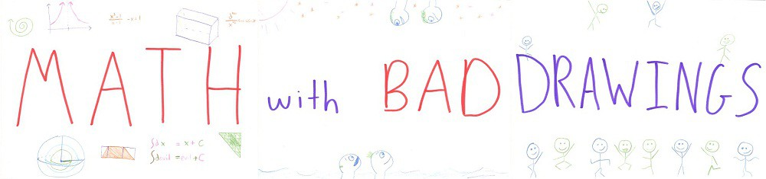

Slide 25
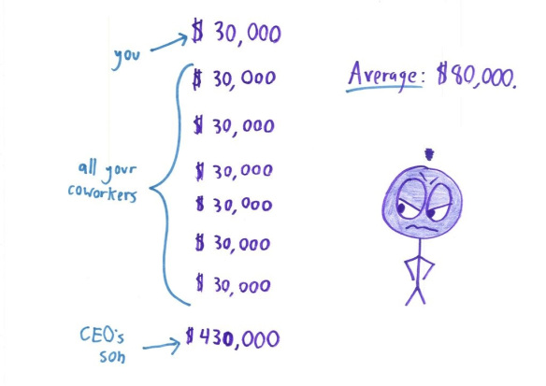

Slide 26
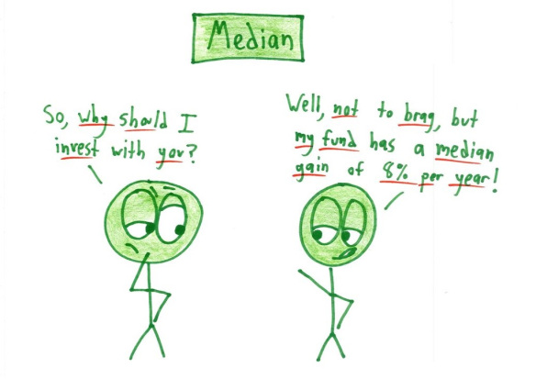

Slide 27
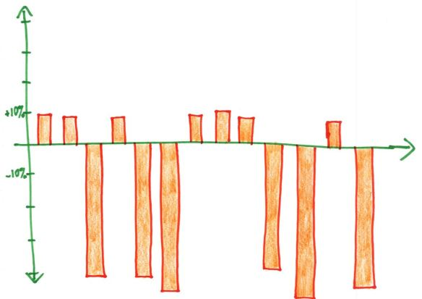

Slide 28
On average (or median), Arithmetic fails….
1 to 6 days + 1 to 6 + 1 to 6 + 1 to 6 + 1 to 6 = 5 to 30 days
3.5 days + 3.5 + 3.5 + 3.5 + 3.5 = 17.5 days

Slide 29

Probabilistic Forecasting combines many uncertain inputs to find many possible outcomes, and what outcomes are more likely than others
50% Possible Outcomes
50% Possible Outcomes
Likelihood
Time to Complete Backlog

Slide 30
Seeing “How Likely”
85% Possible Outcomes
15%
Likelihood
Time to Complete Backlog

Slide 31
Siri, Add 1 to 6 five times.
Cortana, Add 1 to 6 five times.
(sometime later)
Alexa, Buy me some Vodka….

Slide 32
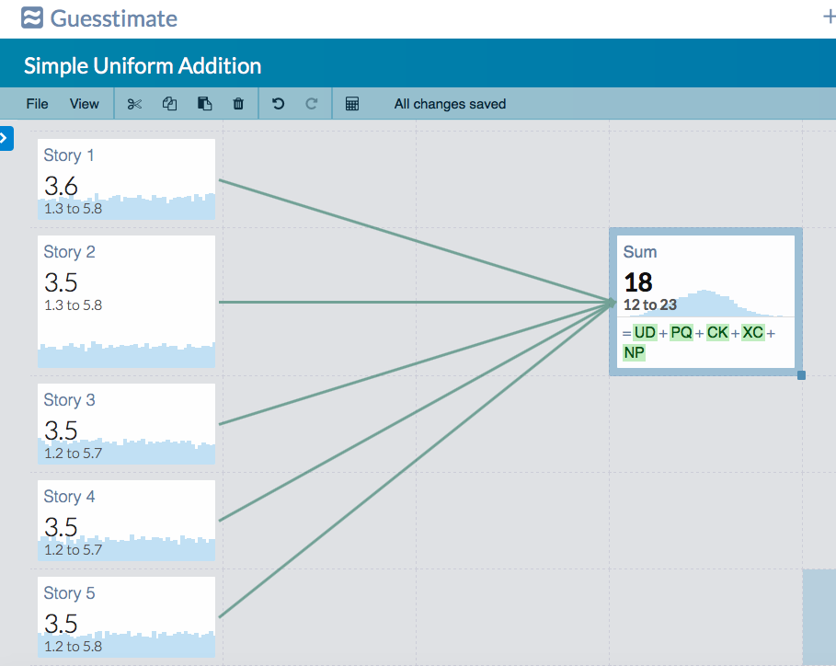
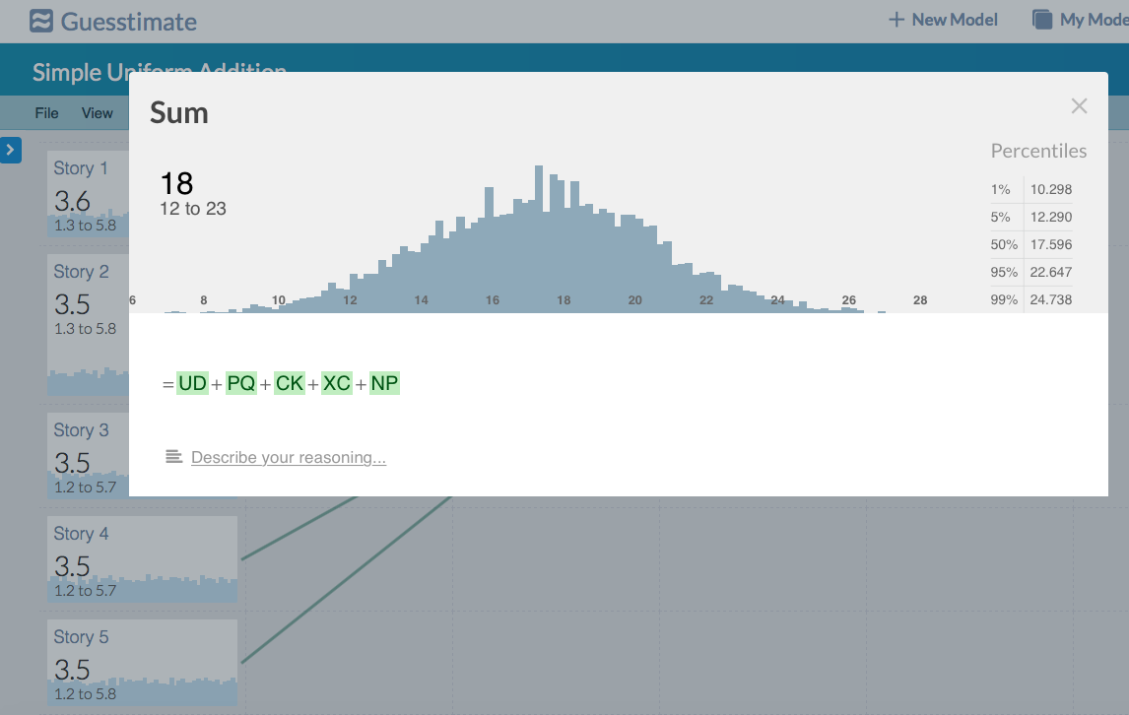

Slide 33

Resampling (Bootstrapping)
Trial 1
Trial 2
Trial 100
9
1
35
9
4
19
35
13
7
5
13
13
5
13
14
11
11
5
5
Sum:
51
28
…
83
1
11
11
7
4
19

Slide 34
Q. Could I make a simple forecast tool that worked?
Without macros or add-ins!
http://bit.ly/ThroughputForecast
Notes:
I set out to prove this by setting myself a challenge to see what I could do with just completed and start dates. You can get the result for yourself by downloading the spreadsheet from bit.ly/Throughput with a capital T. Again, all these links will be tweeted at @t_magennis

Slide 35
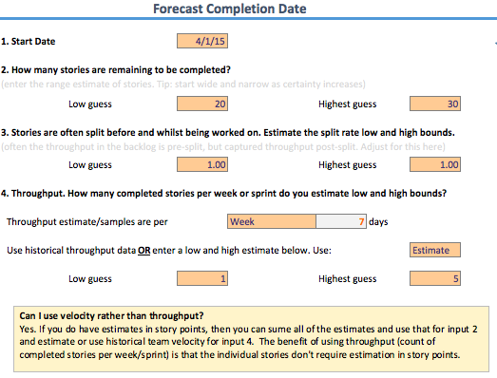
http://bit.ly/ThroughputForecast

Slide 36
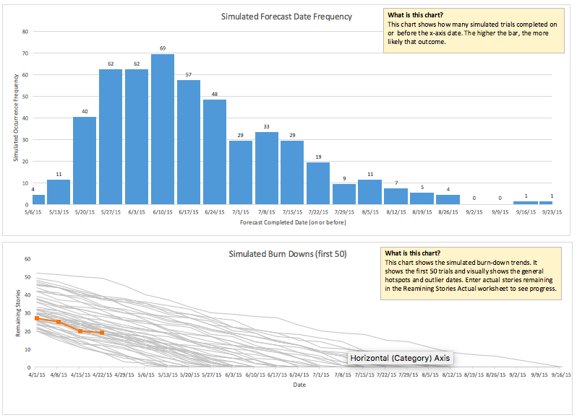
http://bit.ly/ThroughputForecast

Slide 37
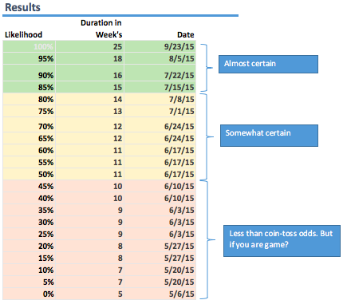
http://bit.ly/ThroughputForecast

Slide 38
Experiment
From a set of *prior* throughput samples, compute the completion rate(s) for the next 6 (six) weeks.
Process –
Repetitively sample prior throughput in sets of 6
Compute how many trials complete at least 10, 20, 30, 40, 50, 60 items in 6 weeks

Slide 39
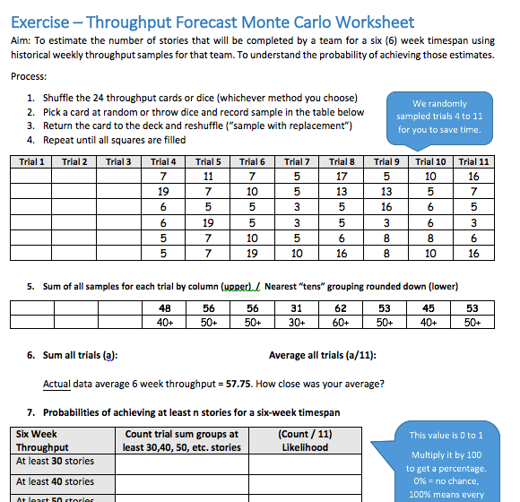

Slide 40
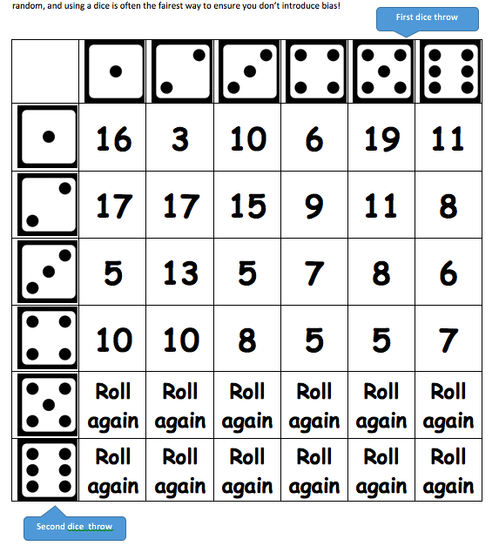
24 Throughput (or velocity) Samples Randomly picked by throwing a dice
1. Throw a 6-sided dice. Pick the column.
2. Throw a six-sided dice and pick the row
3. If it doesn’t say “Roll again” this is your throughput sample.
Fill in the numbers for Trials 1, 2 and 3. I’ve done Trials 4 to 11 so you don’t want to kill me!

Slide 41
Come to the front and give me your Likelihood of 40, 50 and 60 stories
Group | % >= 40 stories | % >= 50 stories | % > 60 stories
1
2
3
4
5
6
7
Group | % >= 40 stories | % >= 50 stories | % > 60 stories
8
9
10
11
12
13
14

Slide 42
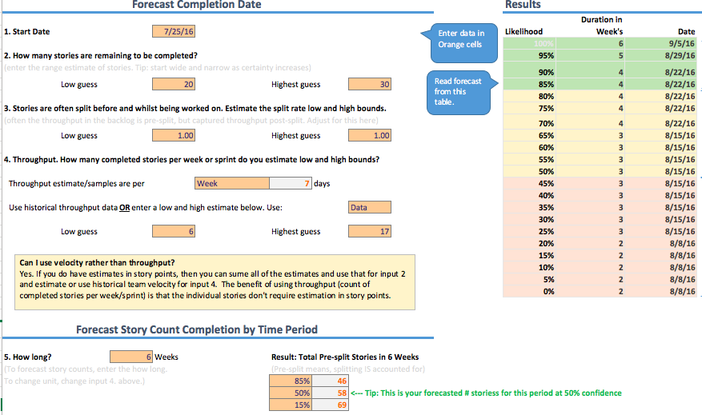

Slide 43
Every spreadsheet and exercise worksheet is here:
Bit.ly/SimResources (gitHub)
or FocusedObjective.com (free stuff)
or @t_magennis (I’ve post links here)

Slide 44
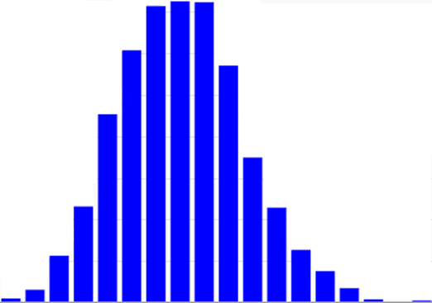
Every choice we make changes the outcome
Planned / Due Date
Actual Date
Staff
Dev Cost
Cost of Delay
July
August
September
October
November
December
Forecast Completion Date

